Slide 1
Association Rule
Support, Confidence and Lift

Slide 2
Association Rules Analysis
Association rules analysis is a technique to uncover how items are associated to each other. There are three common ways to measure association.

Slide 3
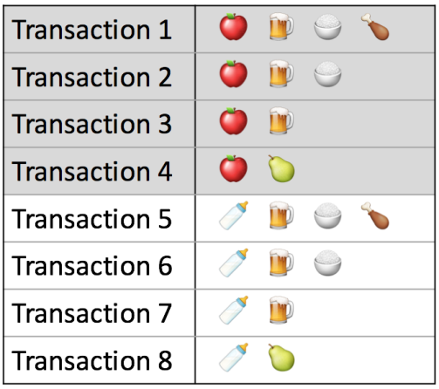
Example transactions

Slide 4

Support
Measure 1: Support. This says how popular an itemset is, as measured by the proportion of transactions in which an itemset appears. In Table 1 below, the support of {apple} is 4 out of 8, or 50%. Itemsets can also contain multiple items. For instance, the support of {apple, beer, rice} is 2 out of 8, or 25%.

Slide 5

Confidence
Measure 2: Confidence. This says how likely item Y is purchased hen item X is purchased, expressed as {X -> Y}.
This is measured by the proportion of transactions with item X, in which item Y also appears. In Table 1, the confidence of {apple -> beer} is 3 out of 4, or 75%.

Slide 6

Lift
Measure 3: This says how likely item Y is purchased when item X is purchased, while controlling for how popular item Y is. In Table 1, the lift of {apple -> beer} is 1,which implies no association between items. A lift value greater than 1 means that item Y is likely to be bought if item X is bought, while a value less than 1 means that item Y is unlikely to be bought if item X is bought.

Slide 7
LIFT
Lift controls for the support (frequency) of consequent while calculating the conditional probability of occurrence of {Y} given {X}. Lift is a very literal term given to this measure. Think of it as the *lift* that {X} provides to our confidence for having {Y} on the cart. To rephrase, lift is the rise in probability of having {Y} on the cart with the knowledge of {X} being present over the probability of having {Y} on the cart without any knowledge about presence of {X}. Mathematically,

Slide 8
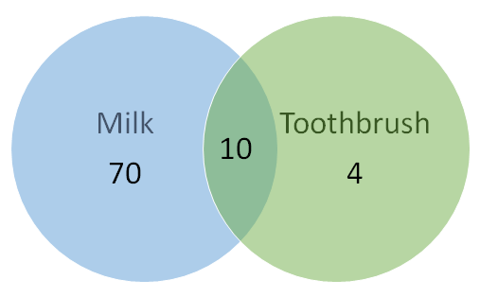
Confidence for {Toothbrush} → {Milk} will be 10/(10+4) = 0.7
Total transactions = 100. 10 of them have both milk and toothbrush, 70 have milk but no toothbrush and 4 have toothbrush but no milk.

Slide 9
Explaination
Looks like a high confidence value. But we know intuitively that these two products have a weak association and there is something misleading about this high confidence value. Lift is introduced to overcome this challenge.

